Slide 1




NEXT GEN EMPLOYABILITY PROGRAM
Creating a future-ready workforce
Team Members
College Name
Student Name :E.VIJAY KUMAR
Student ID :511321104112
KINGSTON ENGINEERING COLLEGE

Slide 2

CAPSTONE PROJECT SHOWCASE
Project Title
Building Bus Reservation System using Python and Django
Abstract | Problem Statement | Project Overview | Proposed Solution | Technology Used | Modelling & Results | Conclusion

Slide 3
Abstract
The Bus Reservation System, developed with Python and Django, simplifies bus ticket booking. Users can search buses, view schedules, select seats, and book online. It offers an intuitive interface for passengers and administrators, managing bookings, routes, and ticket availability seamlessly. Featuring user authentication, payment integration, and real-time updates, it's a convenient solution for travelers and operators.
Key features of the Bus Reservation System include robust user authentication, seamless payment integration, and real-time updates. These functionalities enhance the overall convenience and efficiency of the booking process for travelers and bus operators alike. By providing a comprehensive solution for online bus ticketing, this system simplifies travel arrangements and facilitates smoother operations for both users and service providers.
Source :

Slide 4
Problem Statement
The Bus Reservation System project seeks to address the inefficiencies inherent in traditional bus ticket booking systems, including manual processes, long queues, restricted schedule access, and cumbersome management of bookings and payments. Its primary objective is to develop a comprehensive online platform that revolutionizes the booking experience, providing real-time bus information, ensuring secure transactions, and enhancing user satisfaction for both passengers and operators.
Additionally, the system will incorporate robust administrative features to facilitate efficient route management, schedule updates, seat tracking, and report generation, thereby optimizing the overall efficiency of bus operations. Through streamlined processes and advanced functionalities, the Bus Reservation System aims to modernize the bus ticketing industry and offer a seamless experience to all stakeholders involved.
Source :

Slide 5
Project Overview
The Bus Reservation System project is a comprehensive endeavor aimed at rectifying the limitations inherent in traditional bus ticket booking methods, such as manual processes, prolonged queues, and restricted schedule access. It endeavors to introduce a sophisticated online platform that revolutionizes the booking experience by offering real-time bus updates, secure transactions, and heightened user satisfaction.
Through robust administrative capabilities, the system will facilitate efficient route management, seamless schedule updates, and thorough reporting, thereby optimizing the overall efficiency of bus operations.
By emphasizing streamlined processes and integrating advanced functionalities, the project seeks to propel the bus ticketing industry into the modern era, providing stakeholders with a seamless, efficient, and convenient experience. This ambitious undertaking promises to deliver a significant leap in efficiency and convenience for all involved parties, marking a pivotal advancement in the realm of transportation services.
Source :

Slide 6
Proposed Solution
.
The Bus Reservation System project endeavors to develop a user-friendly web application utilizing Python and Django, empowering passengers to effortlessly search, book, and manage bus tickets online. It will integrate real-time seat availability updates, ensuring accuracy and convenience for users.
Secure payment processing will be a cornerstone feature, bolstering trust and reliability in transactions. Moreover, the system will equip administrators with robust tools for efficient route management, facilitating optimized operations.
Through automation of the booking process, the project aims to significantly enhance convenience for users while simultaneously streamlining operations for bus operators. This holistic approach promises to yield substantial improvements in overall efficiency within the transportation sector, marking a pivotal advancement in modernizing bus ticketing services.
Source :

Slide 7
IMPLEMENTATION STEPS
Requirements Gathering: Gather requirements from stakeholders to understand the functionalities and features needed in the bus reservation system.
System Design: Create a comprehensive design for the system architecture, database structure, and user interface.
Backend Development: Develop the backend logic using Python and Django framework to handle user authentication, bus management, reservation processing, etc.
Frontend Development: Implement the user interface using HTML, CSS, and JavaScript, integrating with Django templates to ensure a seamless user experience.
Database Implementation: Design and implement the database schema using Django's ORM (Object-Relational Mapping) to store data such as users, buses, reservations, etc.
Integration and Testing: Integrate the frontend and backend components, and thoroughly test the application to ensure functionality, usability, and reliability.
Deployment and Maintenance: Deploy the application to a production environment, and provide ongoing maintenance, updates, and support to ensure optimal performance and user satisfaction.
Source :

Slide 8
PROJECT STRUCTURE
The project structure typically consists of directories for managing application logic, templates, static files, and configuration settings:
Main Directory: Contains project-level files like settings.py, urls.py, and manage.py.
App Directory: Contains individual Django applications for specific functionalities like user authentication, bus management, and reservations.
Templates Directory: Stores HTML templates for rendering dynamic content.
Static Directory: Holds static files like CSS, JavaScript, and images used in the frontend.
Media Directory: Stores user-uploaded files like profile pictures or ticket scans.
Virtual Environment: A directory for managing Python dependencies and ensuring project isolation.
Database Directory: Stores database files if using SQLite or migration files if using other databases like PostgreSQL.
Source :

Slide 9


Technology Used
Front-end
Back-end
Source :

Slide 10
Modelling & Results
In the modeling phase of the Bus Reservation System, we define the database schema using Django models. This entails creating classes for entities such as buses, routes, bookings, and users, specifying their attributes and relationships.
The outcome of this phase is a well-structured database schema that delineates how data is organized and the connections between various entities. This schema acts as the framework for storing and managing information within the system, guaranteeing streamlined data storage and retrieval processes.
Result: The modeling phase results in a structured database schema that outlines the organization of data and the connections between different entities. This schema serves as the foundation for storing and managing information within the system, ensuring efficient data storage and retrieval operations
Source :

Slide 11
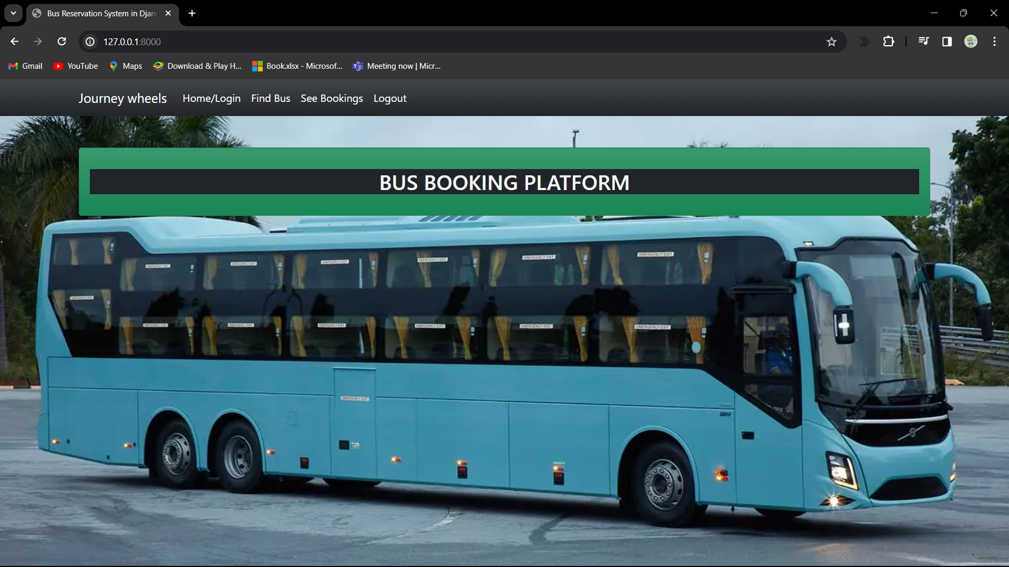
Homepage

Slide 12
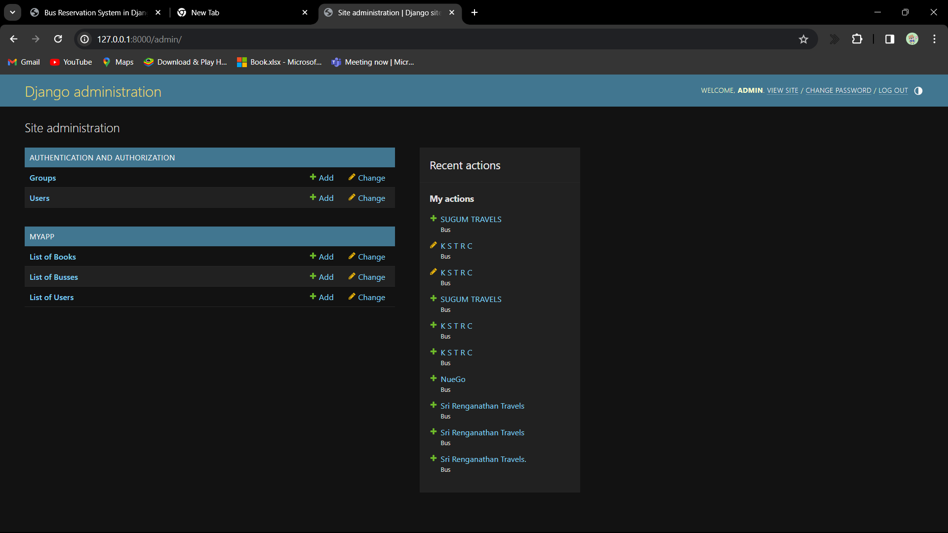
About-Us-Page

Slide 13
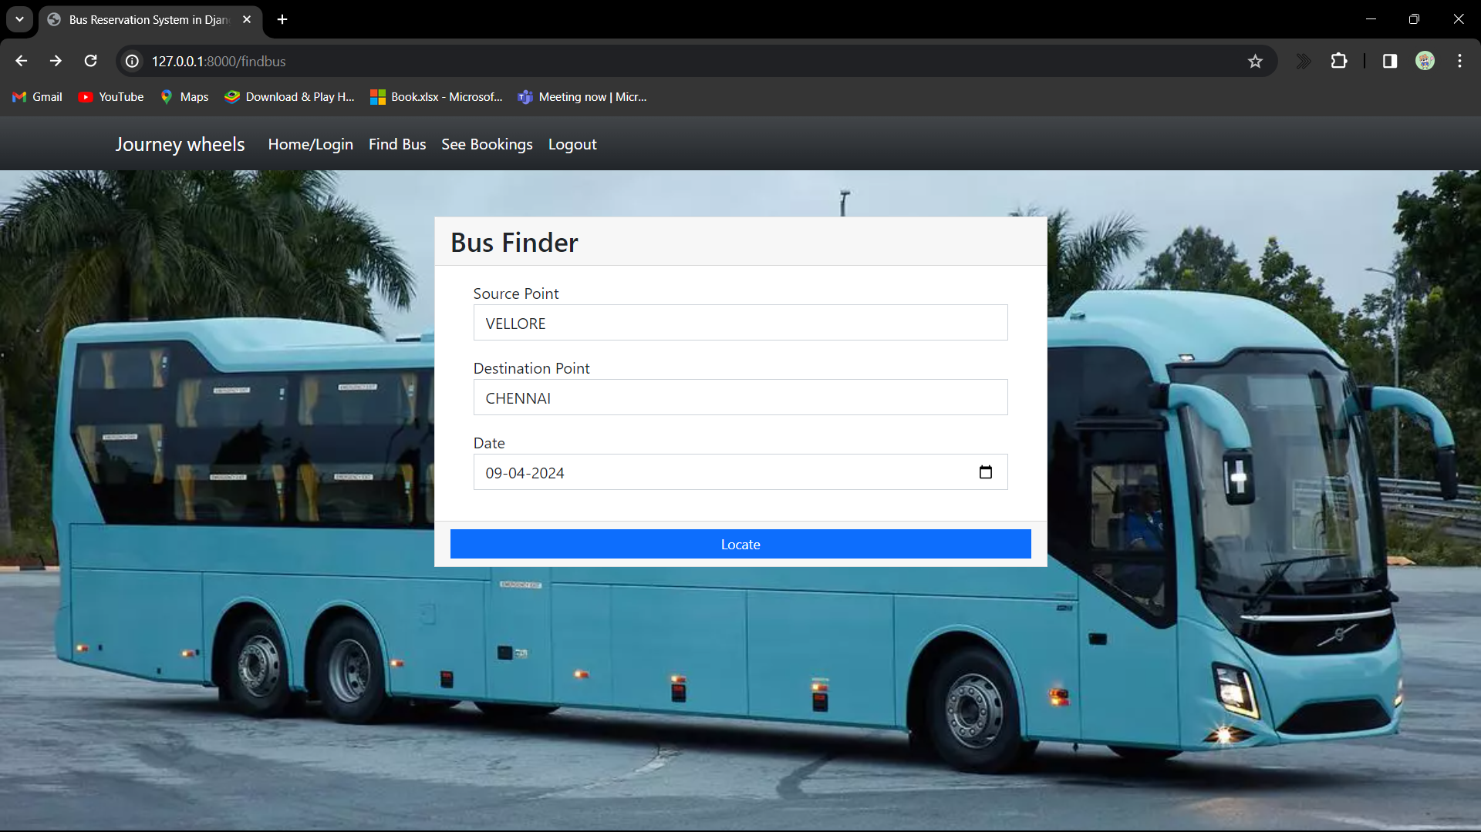
Service-Page

Slide 14
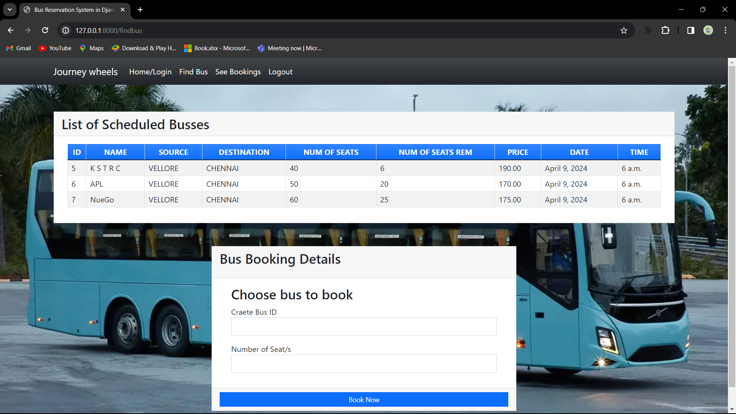
Departments-Page

Slide 15
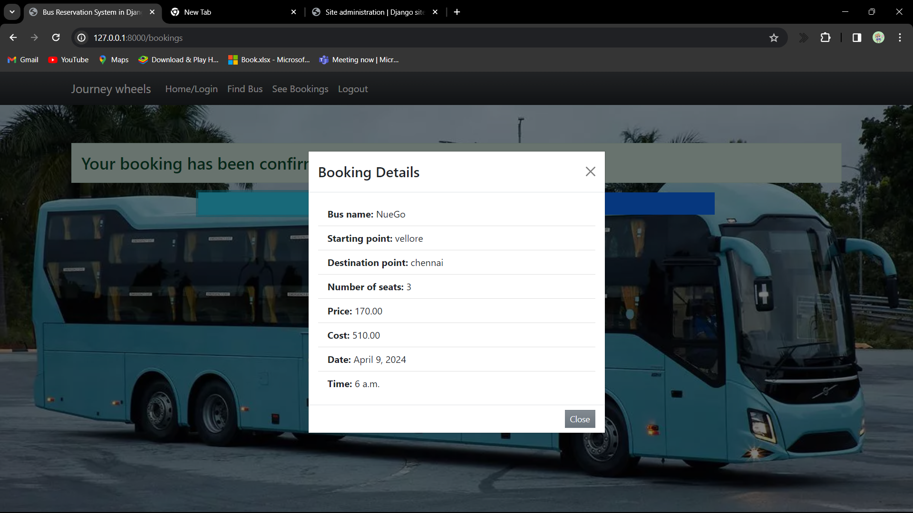
Blog-Page

Slide 16
Future Enhancements: Integration of real-time bus tracking and GPS functionalities to provide accurate bus locations to passengers. Implementation of a feedback system for passengers to rate their travel experience and provide comments, helping to improve service quality. Development of a mobile application for easier access and booking on-the-go. Integration of payment gateways to allow online payments for ticket booking, enhancing convenience for users. Incorporation of dynamic pricing algorithms based on demand and availability to optimize revenue and resource utilization. Integration with third-party travel services to offer seamless intercity or international travel options. Implementation of AI-powered chatbots for customer support, providing instant assistance and resolving queries efficiently.

Slide 17
Conclusion
The online bus reservation system is built using Python and Django, providing a solid foundation for its functionality.
The system prioritizes user experience with a seamless and intuitive interface, making it easy for passengers to book bus tickets.
Through its robust features, the system streamlines operations for bus operators, reducing manual effort and enhancing efficiency.
The system's efficiency and enhanced customer experience contribute to increased revenue generation for bus operators.
With its user-friendly design and convenient booking process, the system aims to enhance customer satisfaction, ensuring a positive experience for passengers.
Overall, this project signifies a notable progression in modernizing the bus travel industry, promising a brighter future with improved efficiency and customer satisfaction.
Source :

Slide 18
Thank You!
Notes:
Thank You !!

